Slide 1
BON VIVANT
DELICATESSEN
Notes:
Hypothesis: Create a Hypothesis with an emphasis on SMART principles. (S – Specific, M – Measurable, A – Achievable, R – Realistic, T – Timebound). If you cannot do this, you do not have a good grasp on the business problem.
Context: With context, we have clearly identified the problem at hand and have elucidated on how our initiative may solve this problem, alongside the commercial implications this will have on the business.
Criteria for Success: Clearly defining the criteria for success ensures that the scope of your work is clearly defined and understood. Otherwise, if this isn’t defined – your work will never end which will result in mismatched expectations.
Scope of Solution Space: Scoping out the solution space ensures that the business initiative is SPECIFIC for a certain segment or area. This prevents solutions that have been developed being scaled and applied for all other business units that the solution may not be responsible or scalable for.
Constraints within Solution Space: Looking forward, what are the foreseeable problems we are likely to encounter? Could this be stakeholder resistance? Could this be we don’t have access to the right data?
Stakeholders to provide key insight: Who are the people I need to speak to, to get the answers I need for my data analysis?
What key data sources are required?
Based off my discussions with the key stakeholders – can we clearly list out all the data sources we need so we can make a highly targeted request as opposed to a scatter-gun approach where we ask for a bit of everything?

Slide 2
PROBLEM STATEMENT
& ISSUE TREE
Notes:
Hypothesis: Create a Hypothesis with an emphasis on SMART principles. (S – Specific, M – Measurable, A – Achievable, R – Realistic, T – Timebound). If you cannot do this, you do not have a good grasp on the business problem.
Context: With context, we have clearly identified the problem at hand and have elucidated on how our initiative may solve this problem, alongside the commercial implications this will have on the business.
Criteria for Success: Clearly defining the criteria for success ensures that the scope of your work is clearly defined and understood. Otherwise, if this isn’t defined – your work will never end which will result in mismatched expectations.
Scope of Solution Space: Scoping out the solution space ensures that the business initiative is SPECIFIC for a certain segment or area. This prevents solutions that have been developed being scaled and applied for all other business units that the solution may not be responsible or scalable for.
Constraints within Solution Space: Looking forward, what are the foreseeable problems we are likely to encounter? Could this be stakeholder resistance? Could this be we don’t have access to the right data?
Stakeholders to provide key insight: Who are the people I need to speak to, to get the answers I need for my data analysis?
What key data sources are required?
Based off my discussions with the key stakeholders – can we clearly list out all the data sources we need so we can make a highly targeted request as opposed to a scatter-gun approach where we ask for a bit of everything?

Slide 3
Bon Vivant Delicatessen: Problem Statement
To develop a BVD customer profile to target only those customers who would be receptive to future offerings while leaving out the non-respondents
BVD
1
Context
4
Constraints within solution space
Globally, the company had solid revenues and a healthy bottom line in the past 3 years; however, the profit growth perspectives for the next 3 years are not promising. For this reason, several strategic initiatives are being considered to invert this situation. One is to improve the performance of marketing activities, with a special focus on marketing campaigns.
Once BVD has its customer profile, will need to maintain a detailed marketing plan moving forward to avoid project scope creep
Misalignment with stakeholders
2
Criteria for success
5
Stakeholders to provide key insight
Clear understanding of BVD’s customer base
Customer retention
Increase in profit margin
Chief Marketing Officer
Chief Analytics Officer
Project Manager
Research & Development
3
Scope of solution space
6
Key data sources
Which products are they purchasing?
Where is the customer purchasing: in-store, catalogue, website
Does the customer prefer gold products or discounted products?
Is the customer an early adopter of new offerings?
Socio-economic and shopping habit data was collected from a random sample of 2,240 customers over the course of a 5-part promotional campaign drive of those who responded to our team
Notes:
Hypothesis: Create a Hypothesis with an emphasis on SMART principles. (S – Specific, M – Measurable, A – Achievable, R – Realistic, T – Timebound). If you cannot do this, you do not have a good grasp on the business problem.
Context: With context, we have clearly identified the problem at hand and have elucidated on how our initiative may solve this problem, alongside the commercial implications this will have on the business.
Criteria for Success: Clearly defining the criteria for success ensures that the scope of your work is clearly defined and understood. Otherwise, if this isn’t defined – your work will never end which will result in mismatched expectations.
Scope of Solution Space: Scoping out the solution space ensures that the business initiative is SPECIFIC for a certain segment or area. This prevents solutions that have been developed being scaled and applied for all other business units that the solution may not be responsible or scalable for.
Constraints within Solution Space: Looking forward, what are the foreseeable problems we are likely to encounter? Could this be stakeholder resistance? Could this be we don’t have access to the right data?
Stakeholders to provide key insight: Who are the people I need to speak to, to get the answers I need for my data analysis?
What key data sources are required?
Based off my discussions with the key stakeholders – can we clearly list out all the data sources we need so we can make a highly targeted request as opposed to a scatter-gun approach where we ask for a bit of everything?

Slide 4
OBJECTIVE: Build a predictive model to help Bon Vivant Delicatessen predict customer behavior. This model will allow the company to cherry pick the customers that are most likely to purchase while leaving out those not interested, making the next campaign highly profitable.
Bon Vivant Delicatessen
Predictive Model for next campaign
Customer Features
Products
Place
Promotion
Campaign tests
1, 2, 3, 4, 5
education
meat
catalogue
Using discounts
marital status
fish
In-store
kid @ home
sweets
website
teen @ home
wine
income
sweets
income
Cust. enrollment date
High demand product?
Where are most purchases being made
Are discounts being used?
Which campaign was the most successful? What was the conversion rate of each campaign?
# of days since last purchase
Low demand product?
Where are discounts used most (catalogue, in-store, website)
complaints
Gold products (Exclusive)
What type of customer purchases mostly gold products? Where do they shop? Which products do they purchase most?
Is there a product that is discounted most often
(meat? Fish? Wine?)
What is the customer profile for an early adopter?
Notes:
Global specialty shop
- several hundred thousand registered customers
- serve almost one million consumers a year
Products:
Wines
Fruits
Meat products
Fish dishes
Sweets
Regular Products
Gold Products (Exclusives)
Purchasing Channels:
In-store
Website
Catalog
total cost of the sample 6-part campaign was $6.7M
revenue generated by the customers who accepted the offer was $3.7M
The objective of the team is to build a predictive model that will produce the highest profit for the next direct marketing campaign, scheduled for the next month. The 6-part campaign aimed to sell a new gadget to the customer base. To build the model, a 6-part campaign involving 2,240 customers were carried out. Customers were selected at random and contacted by phone regarding the acquisition of the gadget. During the following months, customers who bought the offer were properly labeled.

Slide 5
Bon Vivant Delicatessen: Company Profile
Globally renowned food retailer in the speciality food industry
BVD
Bon Vivant Delicatessen is a globally renowned fresh market retailer in the food industry. They sell products from 6 categories:
Wines
Fruits
Meat
Fish
Sweets
Gold (Exclusive) Products
Customers can order and acquire products through 3 sales channels:
Physical Stores
Catalog
Company Website

Slide 6
Bon Vivant Delicatessen: Overview
Globally renowned food retailer in the speciality food industry
BVD
Bon Vivant Delicatessen has had solid revenues and a healthy bottom line over the past 3 years; however, the profit growth perspectives for the next 3 years are not promising.
For this reason, several strategic initiatives are being considered to invert this situation. One is to improve the performance of marketing activities, with a special focus on marketing campaigns.

Slide 7
Bon Vivant Delicatessen: Objective
Globally renowned food retailer in the speciality food industry
BVD
To do this, socio-economic and shopping habit data was collected from a random sample of 2,240 customers
over the course of a 5-part promotional campaign drive
With this data, the team hopes to better understand the customer by gaining insights into
Socioeconomic factors
Spending habits
Campaign acceptance patterns
Modifying marketing campaigns to these distinct customer profiles

Slide 8
SOCIOECONOMIC FACTORS

Slide 9
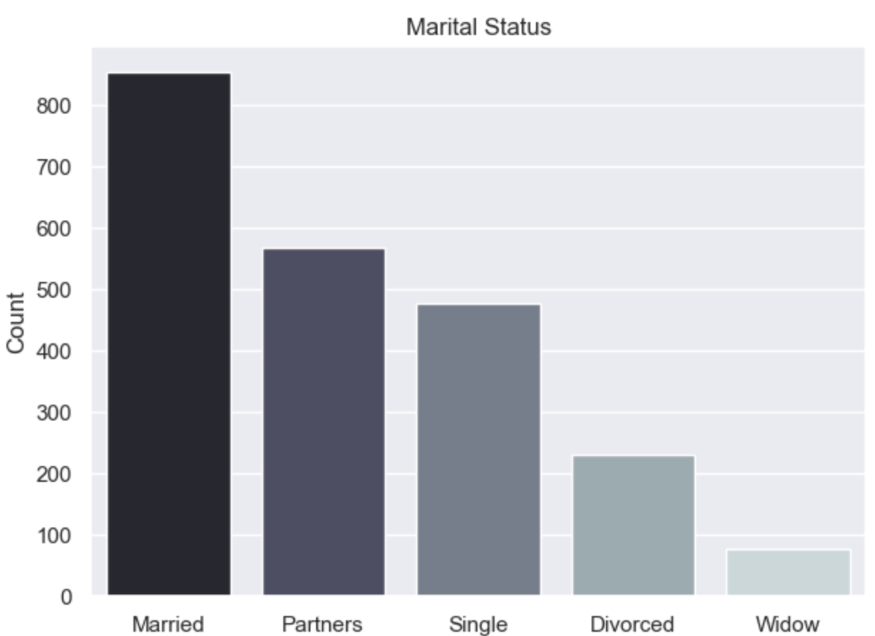
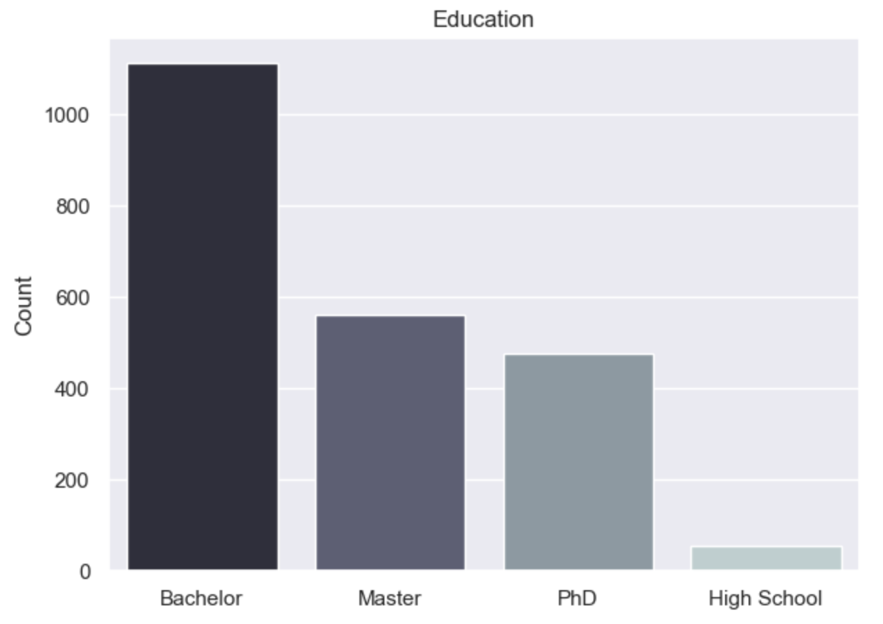
Bon Vivant Delicatessen: Socioeconomic Factors
Globally renowned food retailer in the speciality food industry
BVD
BVD customers are highly educated, married individuals
Notes:
Hypothesis: Create a Hypothesis with an emphasis on SMART principles. (S – Specific, M – Measurable, A – Achievable, R – Realistic, T – Timebound). If you cannot do this, you do not have a good grasp on the business problem.
Context: With context, we have clearly identified the problem at hand and have elucidated on how our initiative may solve this problem, alongside the commercial implications this will have on the business.
Criteria for Success: Clearly defining the criteria for success ensures that the scope of your work is clearly defined and understood. Otherwise, if this isn’t defined – your work will never end which will result in mismatched expectations.
Scope of Solution Space: Scoping out the solution space ensures that the business initiative is SPECIFIC for a certain segment or area. This prevents solutions that have been developed being scaled and applied for all other business units that the solution may not be responsible or scalable for.
Constraints within Solution Space: Looking forward, what are the foreseeable problems we are likely to encounter? Could this be stakeholder resistance? Could this be we don’t have access to the right data?
Stakeholders to provide key insight: Who are the people I need to speak to, to get the answers I need for my data analysis?
What key data sources are required?
Based off my discussions with the key stakeholders – can we clearly list out all the data sources we need so we can make a highly targeted request as opposed to a scatter-gun approach where we ask for a bit of everything?

Slide 10
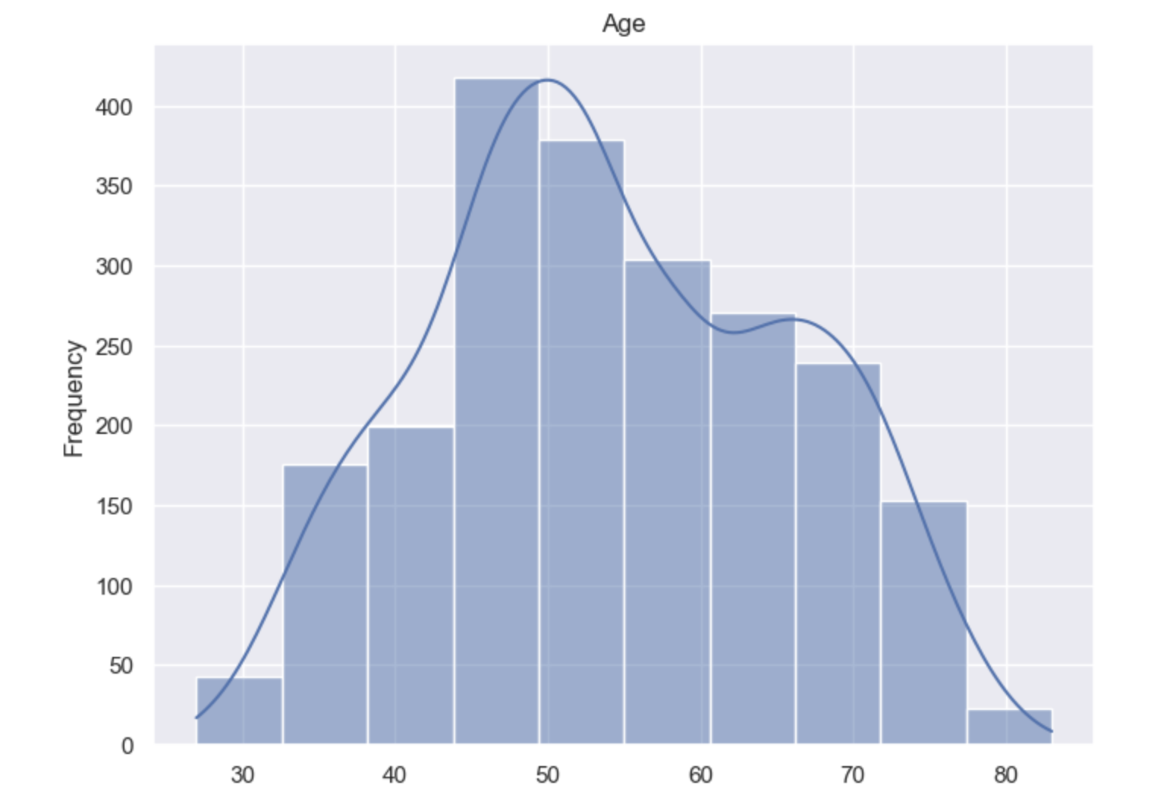
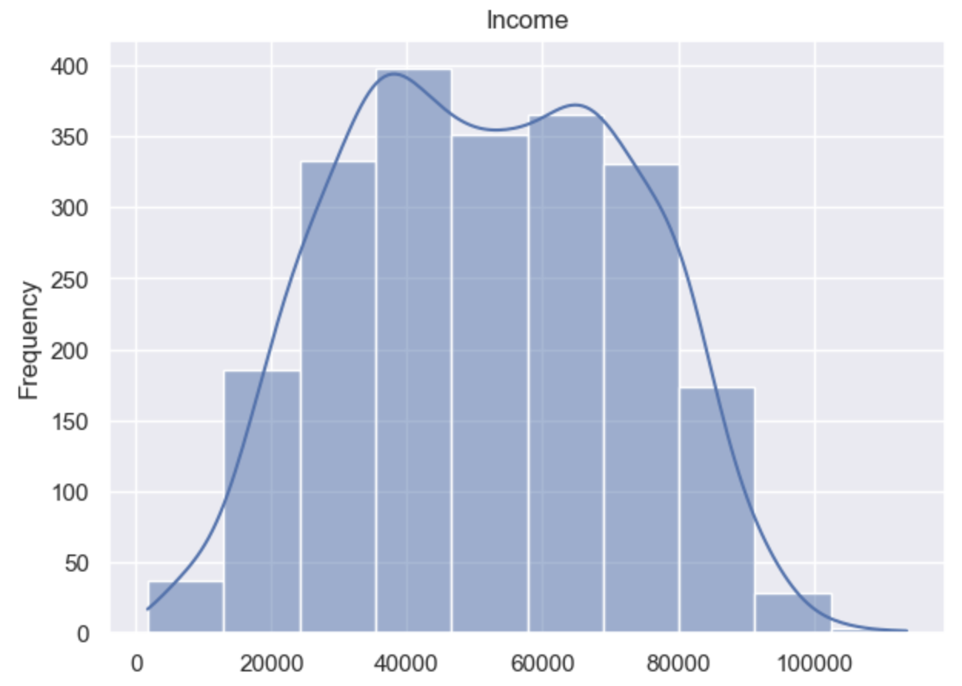
Bon Vivant Delicatessen: Socioeconomic Factors
Globally renowned food retailer in the speciality food industry
BVD
Customers are predominantly in the 40 – 60-year range with an income level between $40,000 and $60,000
Notes:
Hypothesis: Create a Hypothesis with an emphasis on SMART principles. (S – Specific, M – Measurable, A – Achievable, R – Realistic, T – Timebound). If you cannot do this, you do not have a good grasp on the business problem.
Context: With context, we have clearly identified the problem at hand and have elucidated on how our initiative may solve this problem, alongside the commercial implications this will have on the business.
Criteria for Success: Clearly defining the criteria for success ensures that the scope of your work is clearly defined and understood. Otherwise, if this isn’t defined – your work will never end which will result in mismatched expectations.
Scope of Solution Space: Scoping out the solution space ensures that the business initiative is SPECIFIC for a certain segment or area. This prevents solutions that have been developed being scaled and applied for all other business units that the solution may not be responsible or scalable for.
Constraints within Solution Space: Looking forward, what are the foreseeable problems we are likely to encounter? Could this be stakeholder resistance? Could this be we don’t have access to the right data?
Stakeholders to provide key insight: Who are the people I need to speak to, to get the answers I need for my data analysis?
What key data sources are required?
Based off my discussions with the key stakeholders – can we clearly list out all the data sources we need so we can make a highly targeted request as opposed to a scatter-gun approach where we ask for a bit of everything?

Slide 11
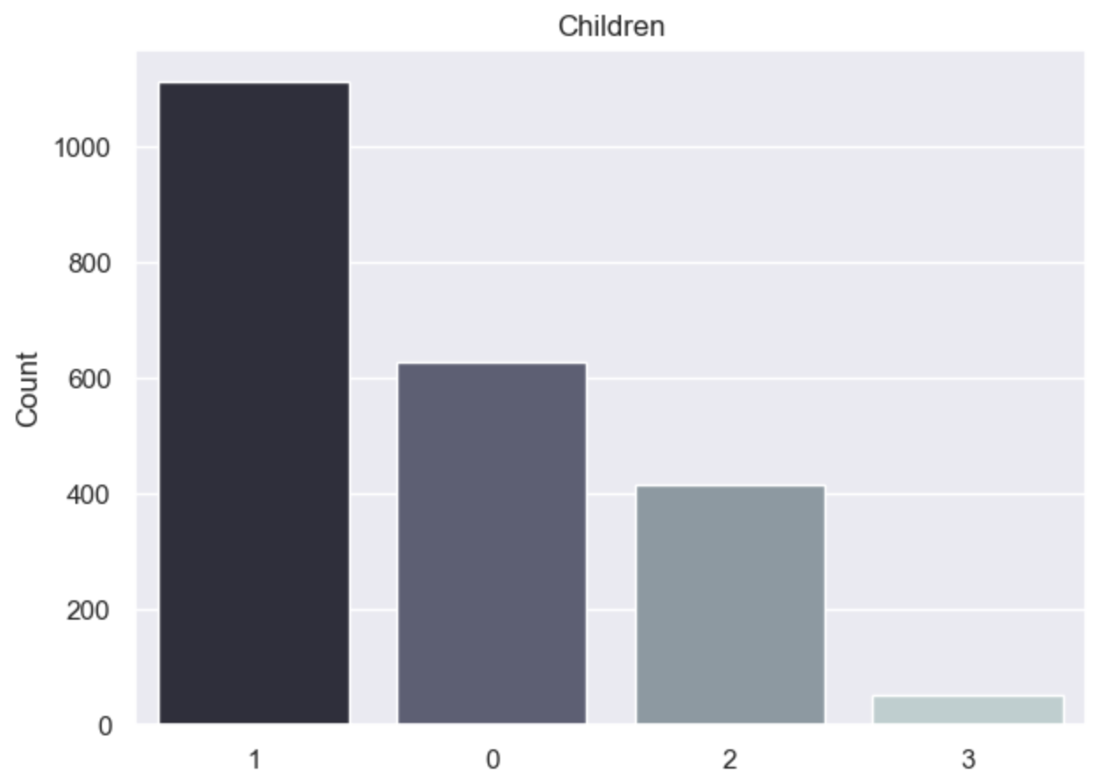
Bon Vivant Delicatessen: Socioeconomic Factors
Globally renowned food retailer in the speciality food industry
BVD
BVD customers predominantly have one dependent
Notes:
Hypothesis: Create a Hypothesis with an emphasis on SMART principles. (S – Specific, M – Measurable, A – Achievable, R – Realistic, T – Timebound). If you cannot do this, you do not have a good grasp on the business problem.
Context: With context, we have clearly identified the problem at hand and have elucidated on how our initiative may solve this problem, alongside the commercial implications this will have on the business.
Criteria for Success: Clearly defining the criteria for success ensures that the scope of your work is clearly defined and understood. Otherwise, if this isn’t defined – your work will never end which will result in mismatched expectations.
Scope of Solution Space: Scoping out the solution space ensures that the business initiative is SPECIFIC for a certain segment or area. This prevents solutions that have been developed being scaled and applied for all other business units that the solution may not be responsible or scalable for.
Constraints within Solution Space: Looking forward, what are the foreseeable problems we are likely to encounter? Could this be stakeholder resistance? Could this be we don’t have access to the right data?
Stakeholders to provide key insight: Who are the people I need to speak to, to get the answers I need for my data analysis?
What key data sources are required?
Based off my discussions with the key stakeholders – can we clearly list out all the data sources we need so we can make a highly targeted request as opposed to a scatter-gun approach where we ask for a bit of everything?

Slide 12
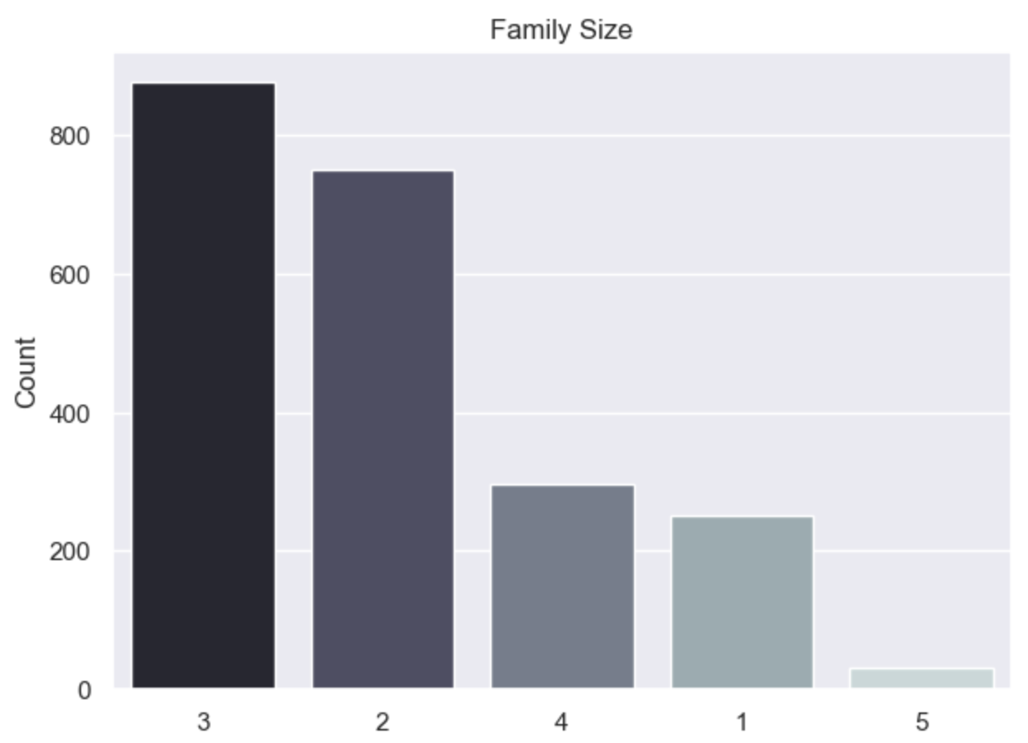
Bon Vivant Delicatessen: Socioeconomic Factors
Globally renowned food retailer in the speciality food industry
BVD
Making a Family Size of three the dominant family dynamic
Notes:
Hypothesis: Create a Hypothesis with an emphasis on SMART principles. (S – Specific, M – Measurable, A – Achievable, R – Realistic, T – Timebound). If you cannot do this, you do not have a good grasp on the business problem.
Context: With context, we have clearly identified the problem at hand and have elucidated on how our initiative may solve this problem, alongside the commercial implications this will have on the business.
Criteria for Success: Clearly defining the criteria for success ensures that the scope of your work is clearly defined and understood. Otherwise, if this isn’t defined – your work will never end which will result in mismatched expectations.
Scope of Solution Space: Scoping out the solution space ensures that the business initiative is SPECIFIC for a certain segment or area. This prevents solutions that have been developed being scaled and applied for all other business units that the solution may not be responsible or scalable for.
Constraints within Solution Space: Looking forward, what are the foreseeable problems we are likely to encounter? Could this be stakeholder resistance? Could this be we don’t have access to the right data?
Stakeholders to provide key insight: Who are the people I need to speak to, to get the answers I need for my data analysis?
What key data sources are required?
Based off my discussions with the key stakeholders – can we clearly list out all the data sources we need so we can make a highly targeted request as opposed to a scatter-gun approach where we ask for a bit of everything?

Slide 13
SPENDING
HABITS
Notes:
Hypothesis: Create a Hypothesis with an emphasis on SMART principles. (S – Specific, M – Measurable, A – Achievable, R – Realistic, T – Timebound). If you cannot do this, you do not have a good grasp on the business problem.
Context: With context, we have clearly identified the problem at hand and have elucidated on how our initiative may solve this problem, alongside the commercial implications this will have on the business.
Criteria for Success: Clearly defining the criteria for success ensures that the scope of your work is clearly defined and understood. Otherwise, if this isn’t defined – your work will never end which will result in mismatched expectations.
Scope of Solution Space: Scoping out the solution space ensures that the business initiative is SPECIFIC for a certain segment or area. This prevents solutions that have been developed being scaled and applied for all other business units that the solution may not be responsible or scalable for.
Constraints within Solution Space: Looking forward, what are the foreseeable problems we are likely to encounter? Could this be stakeholder resistance? Could this be we don’t have access to the right data?
Stakeholders to provide key insight: Who are the people I need to speak to, to get the answers I need for my data analysis?
What key data sources are required?
Based off my discussions with the key stakeholders – can we clearly list out all the data sources we need so we can make a highly targeted request as opposed to a scatter-gun approach where we ask for a bit of everything?

Slide 14
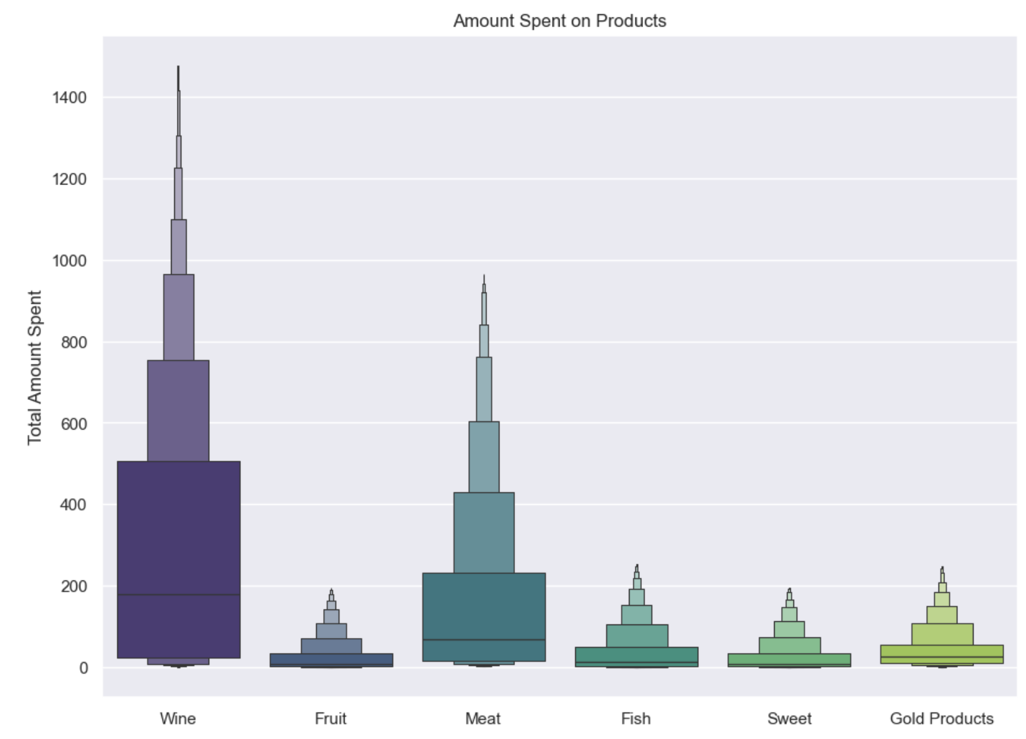
Bon Vivant Delicatessen: Data Exploration: Spending Habits
Globally renowned food retailer in the speciality food industry
BVD
WINE
is the most profitable
product
Followed by
Meat
Fish
Gold Products
Fruit and Sweet profits are similar
Notes:
Hypothesis: Create a Hypothesis with an emphasis on SMART principles. (S – Specific, M – Measurable, A – Achievable, R – Realistic, T – Timebound). If you cannot do this, you do not have a good grasp on the business problem.
Context: With context, we have clearly identified the problem at hand and have elucidated on how our initiative may solve this problem, alongside the commercial implications this will have on the business.
Criteria for Success: Clearly defining the criteria for success ensures that the scope of your work is clearly defined and understood. Otherwise, if this isn’t defined – your work will never end which will result in mismatched expectations.
Scope of Solution Space: Scoping out the solution space ensures that the business initiative is SPECIFIC for a certain segment or area. This prevents solutions that have been developed being scaled and applied for all other business units that the solution may not be responsible or scalable for.
Constraints within Solution Space: Looking forward, what are the foreseeable problems we are likely to encounter? Could this be stakeholder resistance? Could this be we don’t have access to the right data?
Stakeholders to provide key insight: Who are the people I need to speak to, to get the answers I need for my data analysis?
What key data sources are required?
Based off my discussions with the key stakeholders – can we clearly list out all the data sources we need so we can make a highly targeted request as opposed to a scatter-gun approach where we ask for a bit of everything?

Slide 15
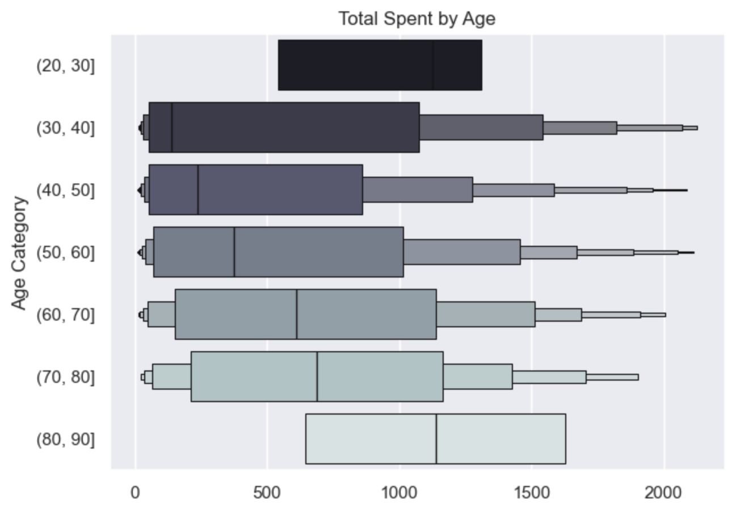
Bon Vivant Delicatessen: Data Exploration: Spending Habits
Globally renowned food retailer in the speciality food industry
BVD
50-80
age groups
Spend relatively the most per purchase
between
~$300-$600
Notes:
Hypothesis: Create a Hypothesis with an emphasis on SMART principles. (S – Specific, M – Measurable, A – Achievable, R – Realistic, T – Timebound). If you cannot do this, you do not have a good grasp on the business problem.
Context: With context, we have clearly identified the problem at hand and have elucidated on how our initiative may solve this problem, alongside the commercial implications this will have on the business.
Criteria for Success: Clearly defining the criteria for success ensures that the scope of your work is clearly defined and understood. Otherwise, if this isn’t defined – your work will never end which will result in mismatched expectations.
Scope of Solution Space: Scoping out the solution space ensures that the business initiative is SPECIFIC for a certain segment or area. This prevents solutions that have been developed being scaled and applied for all other business units that the solution may not be responsible or scalable for.
Constraints within Solution Space: Looking forward, what are the foreseeable problems we are likely to encounter? Could this be stakeholder resistance? Could this be we don’t have access to the right data?
Stakeholders to provide key insight: Who are the people I need to speak to, to get the answers I need for my data analysis?
What key data sources are required?
Based off my discussions with the key stakeholders – can we clearly list out all the data sources we need so we can make a highly targeted request as opposed to a scatter-gun approach where we ask for a bit of everything?

Slide 16
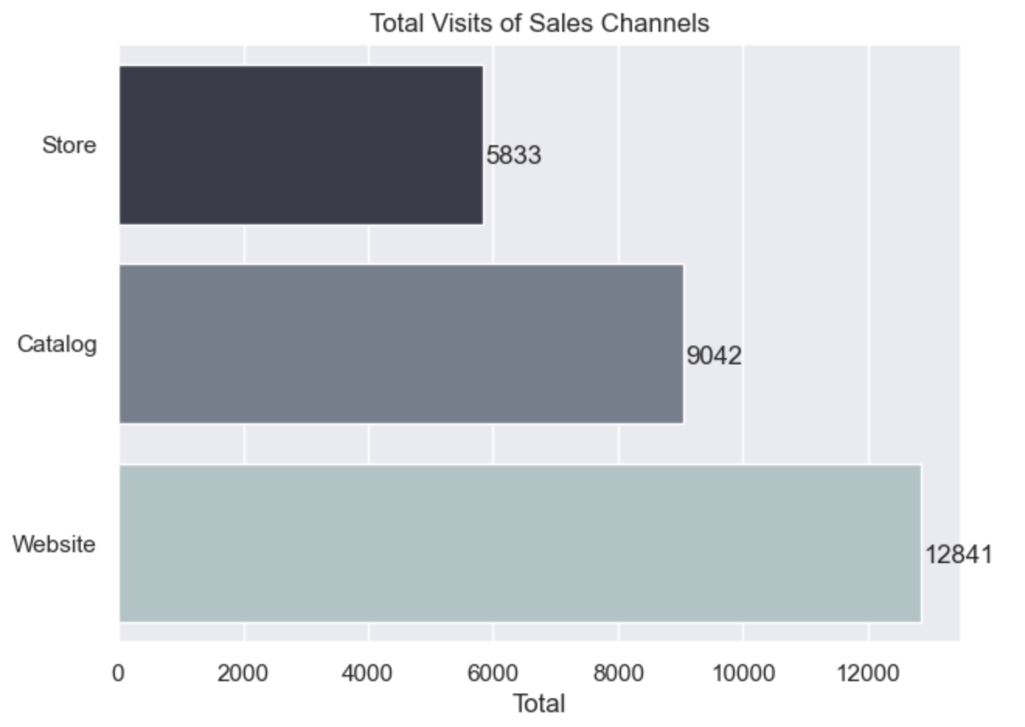
Bon Vivant Delicatessen: Data Exploration: Spending Habits
Globally renowned food retailer in the speciality food industry
BVD
The sales channel that is the most utilized is the
WEBSITE
Followed by
Catalog
Physical Store
Notes:
Hypothesis: Create a Hypothesis with an emphasis on SMART principles. (S – Specific, M – Measurable, A – Achievable, R – Realistic, T – Timebound). If you cannot do this, you do not have a good grasp on the business problem.
Context: With context, we have clearly identified the problem at hand and have elucidated on how our initiative may solve this problem, alongside the commercial implications this will have on the business.
Criteria for Success: Clearly defining the criteria for success ensures that the scope of your work is clearly defined and understood. Otherwise, if this isn’t defined – your work will never end which will result in mismatched expectations.
Scope of Solution Space: Scoping out the solution space ensures that the business initiative is SPECIFIC for a certain segment or area. This prevents solutions that have been developed being scaled and applied for all other business units that the solution may not be responsible or scalable for.
Constraints within Solution Space: Looking forward, what are the foreseeable problems we are likely to encounter? Could this be stakeholder resistance? Could this be we don’t have access to the right data?
Stakeholders to provide key insight: Who are the people I need to speak to, to get the answers I need for my data analysis?
What key data sources are required?
Based off my discussions with the key stakeholders – can we clearly list out all the data sources we need so we can make a highly targeted request as opposed to a scatter-gun approach where we ask for a bit of everything?

Slide 17
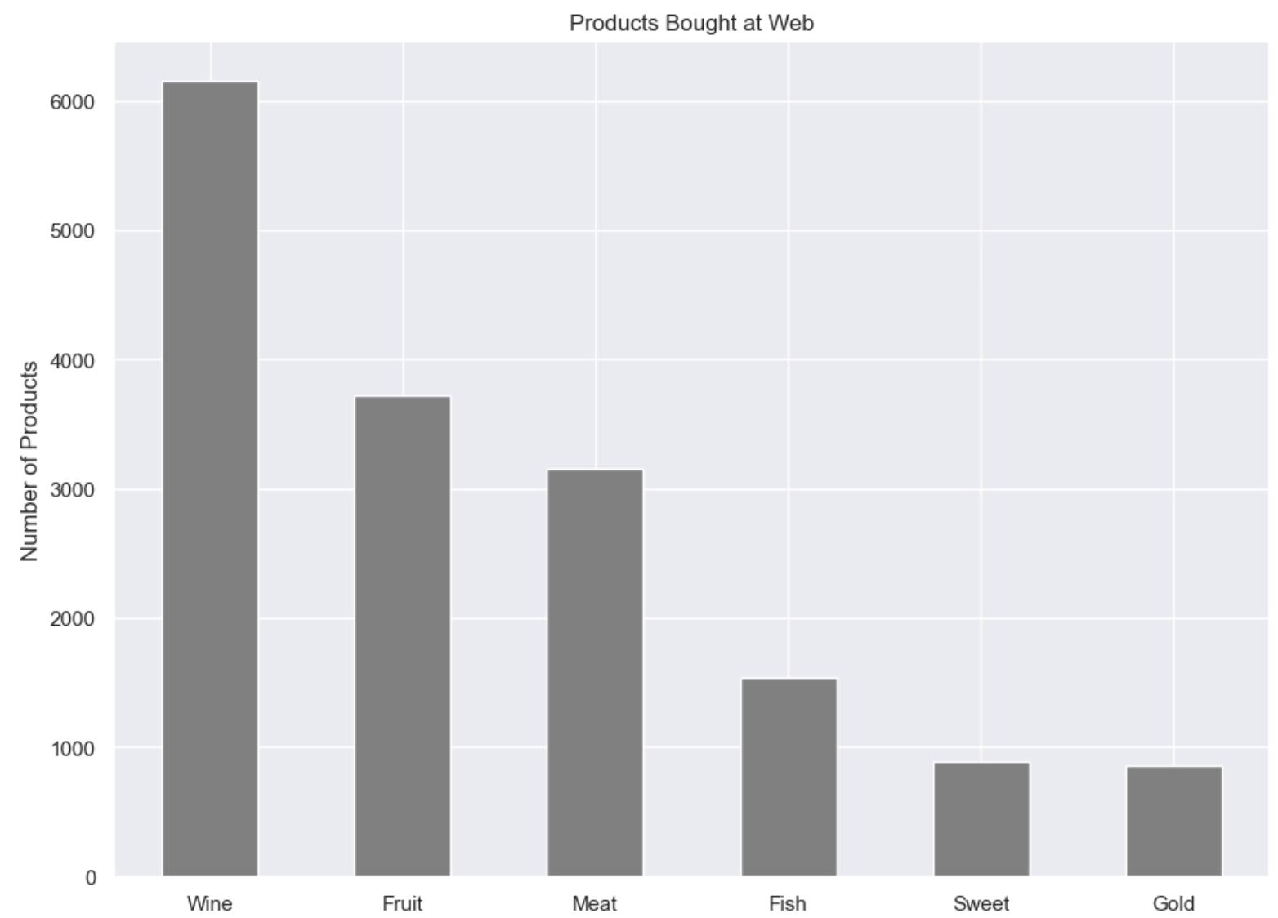
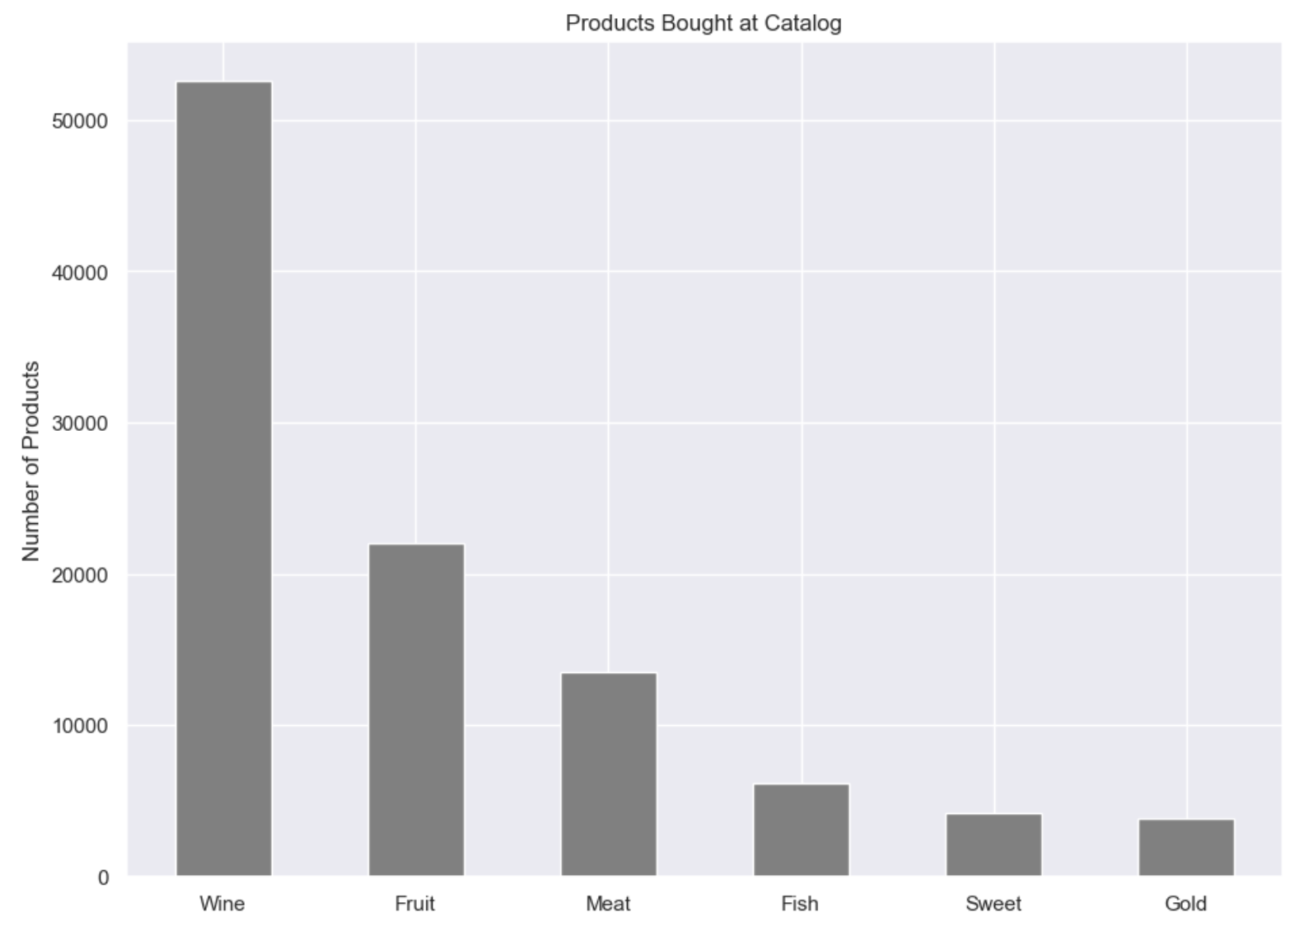
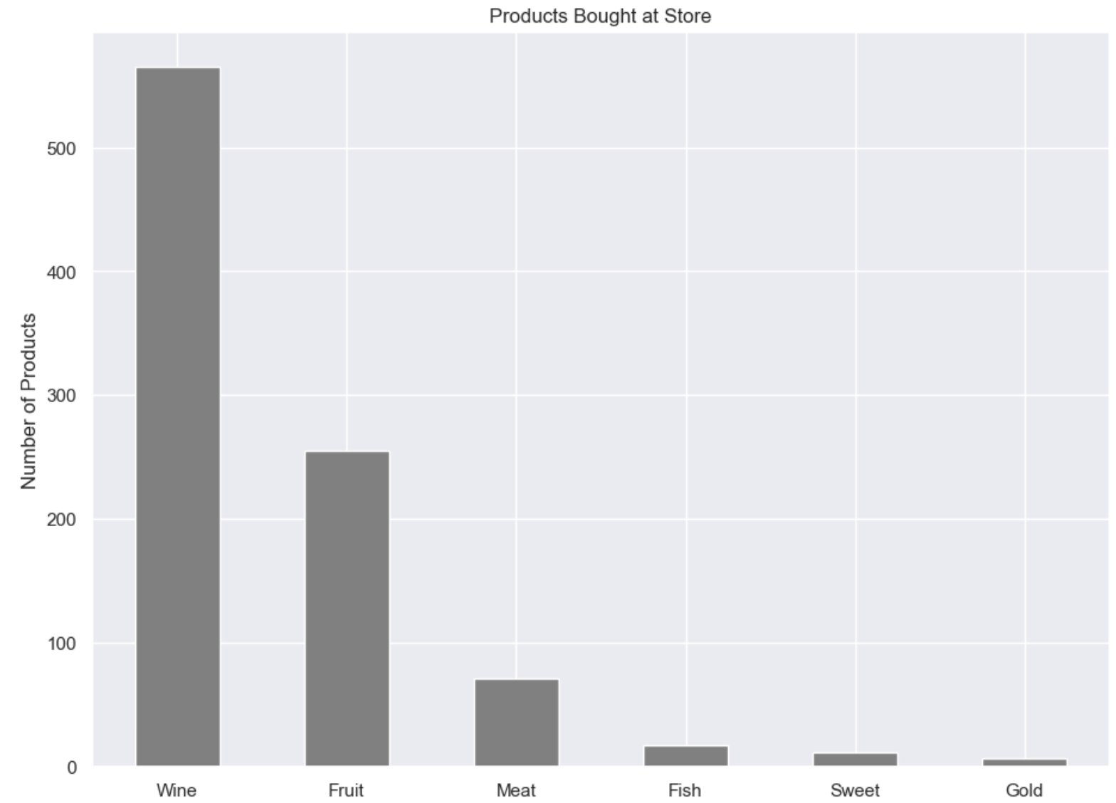
Bon Vivant Delicatessen: Data Exploration: Spending Habits
Globally renowned food retailer in the speciality food industry
BVD
WEBSITE
MOST PURCHASED PRODUCT
WINE
CATALOG
MOST PURCHASED PRODUCT
WINE
PHYSICAL STORE
MOST PURCHASED PRODUCT
WINE
More fish, sweet, and gold products are purchased through the website than either the store or catalog
Notes:
Hypothesis: Create a Hypothesis with an emphasis on SMART principles. (S – Specific, M – Measurable, A – Achievable, R – Realistic, T – Timebound). If you cannot do this, you do not have a good grasp on the business problem.
Context: With context, we have clearly identified the problem at hand and have elucidated on how our initiative may solve this problem, alongside the commercial implications this will have on the business.
Criteria for Success: Clearly defining the criteria for success ensures that the scope of your work is clearly defined and understood. Otherwise, if this isn’t defined – your work will never end which will result in mismatched expectations.
Scope of Solution Space: Scoping out the solution space ensures that the business initiative is SPECIFIC for a certain segment or area. This prevents solutions that have been developed being scaled and applied for all other business units that the solution may not be responsible or scalable for.
Constraints within Solution Space: Looking forward, what are the foreseeable problems we are likely to encounter? Could this be stakeholder resistance? Could this be we don’t have access to the right data?
Stakeholders to provide key insight: Who are the people I need to speak to, to get the answers I need for my data analysis?
What key data sources are required?
Based off my discussions with the key stakeholders – can we clearly list out all the data sources we need so we can make a highly targeted request as opposed to a scatter-gun approach where we ask for a bit of everything?

Slide 18
CORRELATIONS
Notes:
Hypothesis: Create a Hypothesis with an emphasis on SMART principles. (S – Specific, M – Measurable, A – Achievable, R – Realistic, T – Timebound). If you cannot do this, you do not have a good grasp on the business problem.
Context: With context, we have clearly identified the problem at hand and have elucidated on how our initiative may solve this problem, alongside the commercial implications this will have on the business.
Criteria for Success: Clearly defining the criteria for success ensures that the scope of your work is clearly defined and understood. Otherwise, if this isn’t defined – your work will never end which will result in mismatched expectations.
Scope of Solution Space: Scoping out the solution space ensures that the business initiative is SPECIFIC for a certain segment or area. This prevents solutions that have been developed being scaled and applied for all other business units that the solution may not be responsible or scalable for.
Constraints within Solution Space: Looking forward, what are the foreseeable problems we are likely to encounter? Could this be stakeholder resistance? Could this be we don’t have access to the right data?
Stakeholders to provide key insight: Who are the people I need to speak to, to get the answers I need for my data analysis?
What key data sources are required?
Based off my discussions with the key stakeholders – can we clearly list out all the data sources we need so we can make a highly targeted request as opposed to a scatter-gun approach where we ask for a bit of everything?

Slide 19
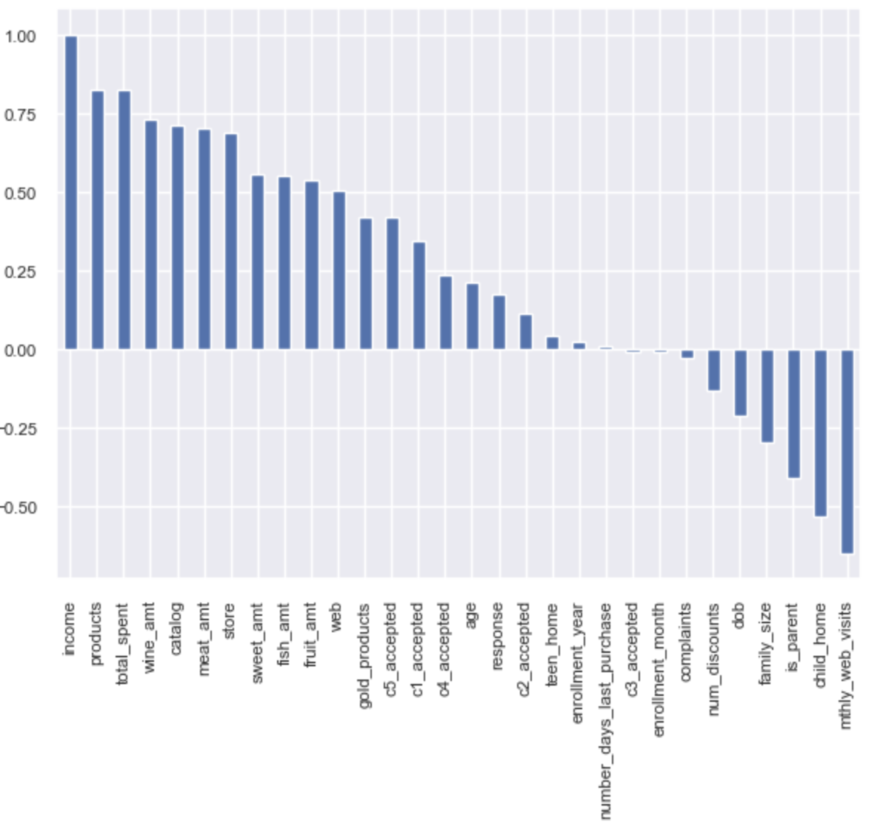
Bon Vivant Delicatessen: Data Exploration: Correlations
Globally renowned food retailer in the speciality food industry
BVD
INCOME &
TOTAL SPENT
Is highly correlated as is the purchase of wine
Notes:
Hypothesis: Create a Hypothesis with an emphasis on SMART principles. (S – Specific, M – Measurable, A – Achievable, R – Realistic, T – Timebound). If you cannot do this, you do not have a good grasp on the business problem.
Context: With context, we have clearly identified the problem at hand and have elucidated on how our initiative may solve this problem, alongside the commercial implications this will have on the business.
Criteria for Success: Clearly defining the criteria for success ensures that the scope of your work is clearly defined and understood. Otherwise, if this isn’t defined – your work will never end which will result in mismatched expectations.
Scope of Solution Space: Scoping out the solution space ensures that the business initiative is SPECIFIC for a certain segment or area. This prevents solutions that have been developed being scaled and applied for all other business units that the solution may not be responsible or scalable for.
Constraints within Solution Space: Looking forward, what are the foreseeable problems we are likely to encounter? Could this be stakeholder resistance? Could this be we don’t have access to the right data?
Stakeholders to provide key insight: Who are the people I need to speak to, to get the answers I need for my data analysis?
What key data sources are required?
Based off my discussions with the key stakeholders – can we clearly list out all the data sources we need so we can make a highly targeted request as opposed to a scatter-gun approach where we ask for a bit of everything?

Slide 20
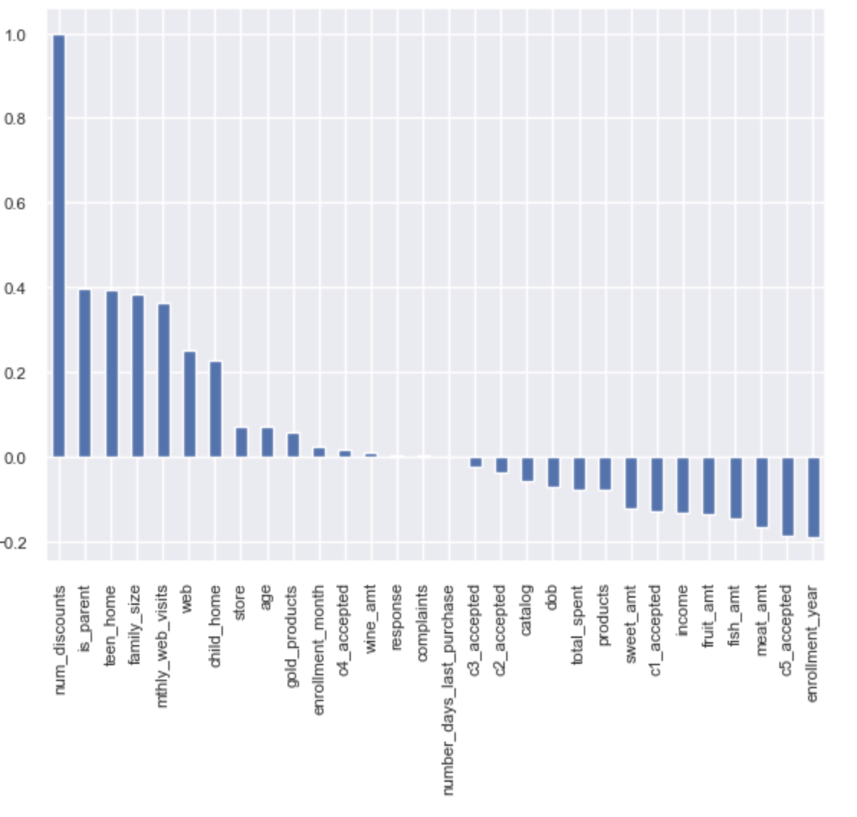
Bon Vivant Delicatessen: Data Exploration: Correlations
Globally renowned food retailer in the speciality food industry
BVD
FAMILY
DYNAMICS &
DISCOUNTED PURCHASES
highly correlated, especially if teen at home
Notes:
Hypothesis: Create a Hypothesis with an emphasis on SMART principles. (S – Specific, M – Measurable, A – Achievable, R – Realistic, T – Timebound). If you cannot do this, you do not have a good grasp on the business problem.
Context: With context, we have clearly identified the problem at hand and have elucidated on how our initiative may solve this problem, alongside the commercial implications this will have on the business.
Criteria for Success: Clearly defining the criteria for success ensures that the scope of your work is clearly defined and understood. Otherwise, if this isn’t defined – your work will never end which will result in mismatched expectations.
Scope of Solution Space: Scoping out the solution space ensures that the business initiative is SPECIFIC for a certain segment or area. This prevents solutions that have been developed being scaled and applied for all other business units that the solution may not be responsible or scalable for.
Constraints within Solution Space: Looking forward, what are the foreseeable problems we are likely to encounter? Could this be stakeholder resistance? Could this be we don’t have access to the right data?
Stakeholders to provide key insight: Who are the people I need to speak to, to get the answers I need for my data analysis?
What key data sources are required?
Based off my discussions with the key stakeholders – can we clearly list out all the data sources we need so we can make a highly targeted request as opposed to a scatter-gun approach where we ask for a bit of everything?

Slide 21
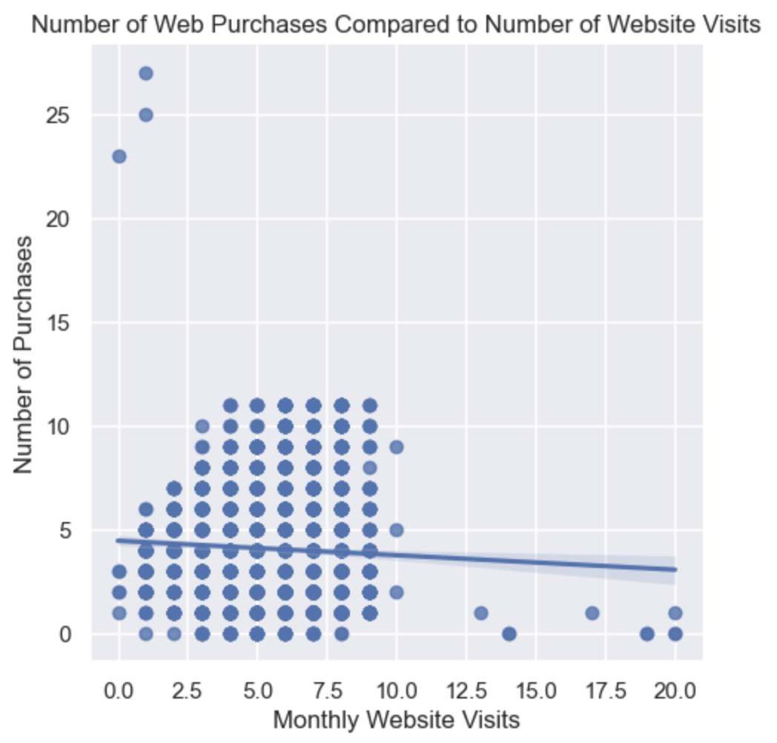
Bon Vivant Delicatessen: Data Exploration: Correlations
Globally renowned food retailer in the speciality food industry
BVD
NUMBER OF WEBSITE VISITS
&
REGULAR PURCHASES
are not correlated

Slide 22
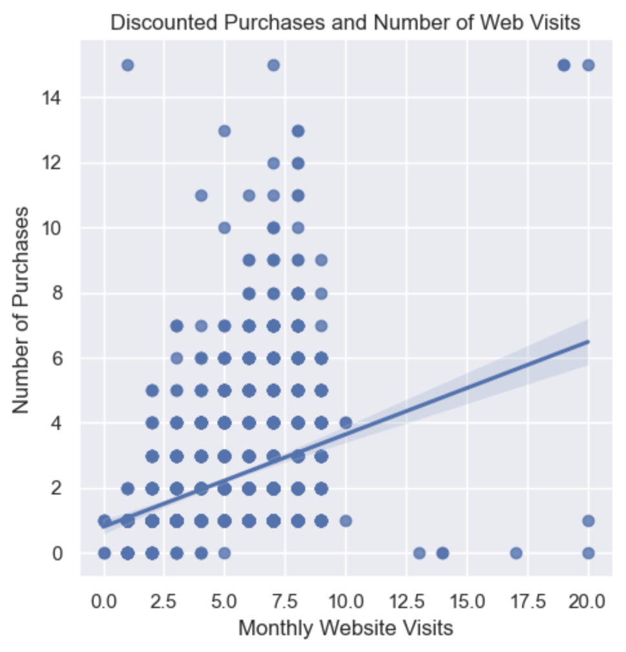
Bon Vivant Delicatessen: Data Exploration: Correlations
Globally renowned food retailer in the speciality food industry
BVD
NUMBER OF
WEB VISITS
&
NUMBER OF DISCOUNTED PURCHASES
Have a correlation
Notes:
Hypothesis: Create a Hypothesis with an emphasis on SMART principles. (S – Specific, M – Measurable, A – Achievable, R – Realistic, T – Timebound). If you cannot do this, you do not have a good grasp on the business problem.
Context: With context, we have clearly identified the problem at hand and have elucidated on how our initiative may solve this problem, alongside the commercial implications this will have on the business.
Criteria for Success: Clearly defining the criteria for success ensures that the scope of your work is clearly defined and understood. Otherwise, if this isn’t defined – your work will never end which will result in mismatched expectations.
Scope of Solution Space: Scoping out the solution space ensures that the business initiative is SPECIFIC for a certain segment or area. This prevents solutions that have been developed being scaled and applied for all other business units that the solution may not be responsible or scalable for.
Constraints within Solution Space: Looking forward, what are the foreseeable problems we are likely to encounter? Could this be stakeholder resistance? Could this be we don’t have access to the right data?
Stakeholders to provide key insight: Who are the people I need to speak to, to get the answers I need for my data analysis?
What key data sources are required?
Based off my discussions with the key stakeholders – can we clearly list out all the data sources we need so we can make a highly targeted request as opposed to a scatter-gun approach where we ask for a bit of everything?

Slide 23
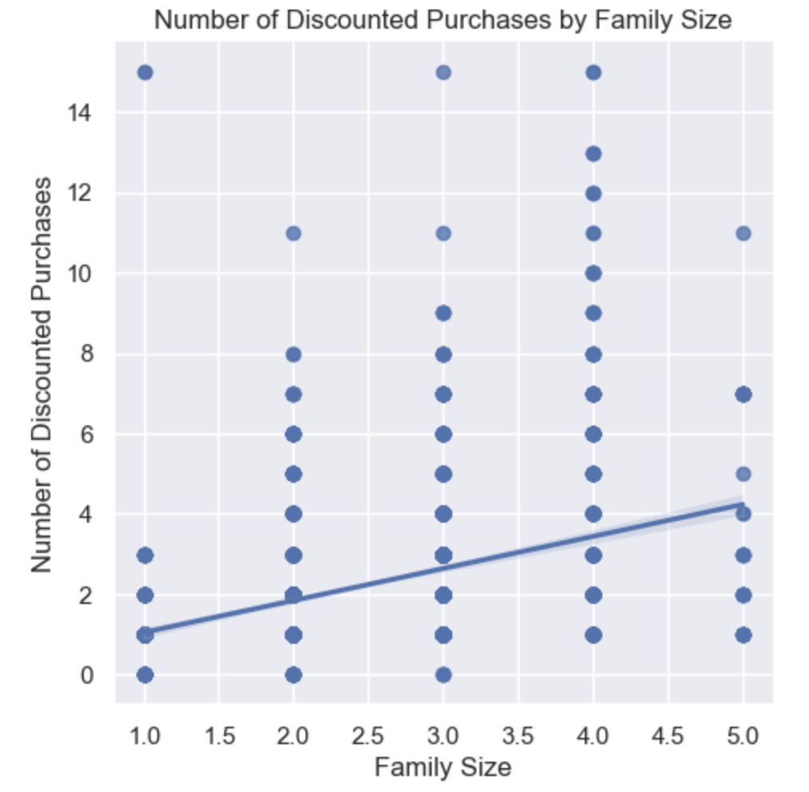
Bon Vivant Delicatessen: Data Exploration: Correlations
Globally renowned food retailer in the speciality food industry
BVD
DISCOUNTED PURCHASES
&
FAMILY SIZE
There is a correlation
between the two
Notes:
Hypothesis: Create a Hypothesis with an emphasis on SMART principles. (S – Specific, M – Measurable, A – Achievable, R – Realistic, T – Timebound). If you cannot do this, you do not have a good grasp on the business problem.
Context: With context, we have clearly identified the problem at hand and have elucidated on how our initiative may solve this problem, alongside the commercial implications this will have on the business.
Criteria for Success: Clearly defining the criteria for success ensures that the scope of your work is clearly defined and understood. Otherwise, if this isn’t defined – your work will never end which will result in mismatched expectations.
Scope of Solution Space: Scoping out the solution space ensures that the business initiative is SPECIFIC for a certain segment or area. This prevents solutions that have been developed being scaled and applied for all other business units that the solution may not be responsible or scalable for.
Constraints within Solution Space: Looking forward, what are the foreseeable problems we are likely to encounter? Could this be stakeholder resistance? Could this be we don’t have access to the right data?
Stakeholders to provide key insight: Who are the people I need to speak to, to get the answers I need for my data analysis?
What key data sources are required?
Based off my discussions with the key stakeholders – can we clearly list out all the data sources we need so we can make a highly targeted request as opposed to a scatter-gun approach where we ask for a bit of everything?

Slide 24
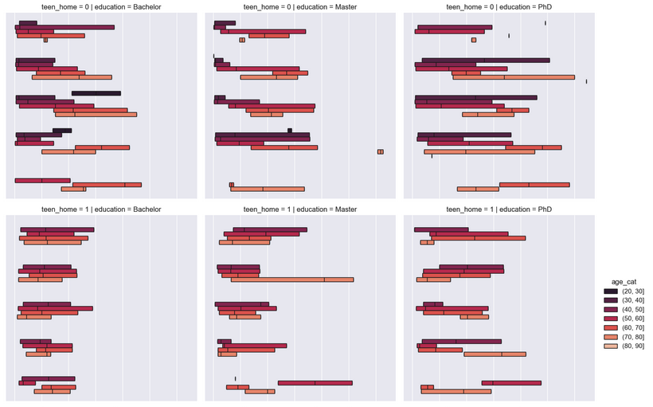
Bon Vivant Delicatessen: Data Exploration: Correlations
Globally renowned food retailer in the speciality food industry
BVD
70-80
with teen at home
are purchasing the most wine

Slide 25
CAMPAIGN
SUCCESS
Notes:
Hypothesis: Create a Hypothesis with an emphasis on SMART principles. (S – Specific, M – Measurable, A – Achievable, R – Realistic, T – Timebound). If you cannot do this, you do not have a good grasp on the business problem.
Context: With context, we have clearly identified the problem at hand and have elucidated on how our initiative may solve this problem, alongside the commercial implications this will have on the business.
Criteria for Success: Clearly defining the criteria for success ensures that the scope of your work is clearly defined and understood. Otherwise, if this isn’t defined – your work will never end which will result in mismatched expectations.
Scope of Solution Space: Scoping out the solution space ensures that the business initiative is SPECIFIC for a certain segment or area. This prevents solutions that have been developed being scaled and applied for all other business units that the solution may not be responsible or scalable for.
Constraints within Solution Space: Looking forward, what are the foreseeable problems we are likely to encounter? Could this be stakeholder resistance? Could this be we don’t have access to the right data?
Stakeholders to provide key insight: Who are the people I need to speak to, to get the answers I need for my data analysis?
What key data sources are required?
Based off my discussions with the key stakeholders – can we clearly list out all the data sources we need so we can make a highly targeted request as opposed to a scatter-gun approach where we ask for a bit of everything?

Slide 26
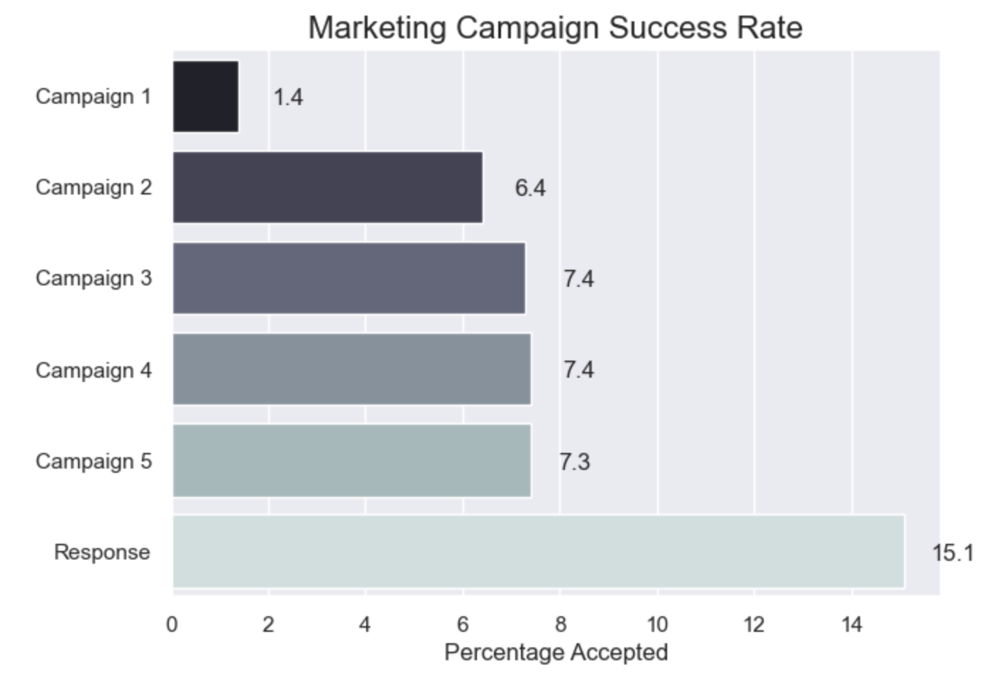
Bon Vivant Delicatessen: Data Exploration: Campaign Success
Globally renowned food retailer in the speciality food industry
BVD
CAMPAIGNS
3 & 4
were the campaigns points most customers were receptive to accepting offers
Notes:
Hypothesis: Create a Hypothesis with an emphasis on SMART principles. (S – Specific, M – Measurable, A – Achievable, R – Realistic, T – Timebound). If you cannot do this, you do not have a good grasp on the business problem.
Context: With context, we have clearly identified the problem at hand and have elucidated on how our initiative may solve this problem, alongside the commercial implications this will have on the business.
Criteria for Success: Clearly defining the criteria for success ensures that the scope of your work is clearly defined and understood. Otherwise, if this isn’t defined – your work will never end which will result in mismatched expectations.
Scope of Solution Space: Scoping out the solution space ensures that the business initiative is SPECIFIC for a certain segment or area. This prevents solutions that have been developed being scaled and applied for all other business units that the solution may not be responsible or scalable for.
Constraints within Solution Space: Looking forward, what are the foreseeable problems we are likely to encounter? Could this be stakeholder resistance? Could this be we don’t have access to the right data?
Stakeholders to provide key insight: Who are the people I need to speak to, to get the answers I need for my data analysis?
What key data sources are required?
Based off my discussions with the key stakeholders – can we clearly list out all the data sources we need so we can make a highly targeted request as opposed to a scatter-gun approach where we ask for a bit of everything?

Slide 27
CUSTOMER
PROFILE
Notes:
Hypothesis: Create a Hypothesis with an emphasis on SMART principles. (S – Specific, M – Measurable, A – Achievable, R – Realistic, T – Timebound). If you cannot do this, you do not have a good grasp on the business problem.
Context: With context, we have clearly identified the problem at hand and have elucidated on how our initiative may solve this problem, alongside the commercial implications this will have on the business.
Criteria for Success: Clearly defining the criteria for success ensures that the scope of your work is clearly defined and understood. Otherwise, if this isn’t defined – your work will never end which will result in mismatched expectations.
Scope of Solution Space: Scoping out the solution space ensures that the business initiative is SPECIFIC for a certain segment or area. This prevents solutions that have been developed being scaled and applied for all other business units that the solution may not be responsible or scalable for.
Constraints within Solution Space: Looking forward, what are the foreseeable problems we are likely to encounter? Could this be stakeholder resistance? Could this be we don’t have access to the right data?
Stakeholders to provide key insight: Who are the people I need to speak to, to get the answers I need for my data analysis?
What key data sources are required?
Based off my discussions with the key stakeholders – can we clearly list out all the data sources we need so we can make a highly targeted request as opposed to a scatter-gun approach where we ask for a bit of everything?

Slide 28
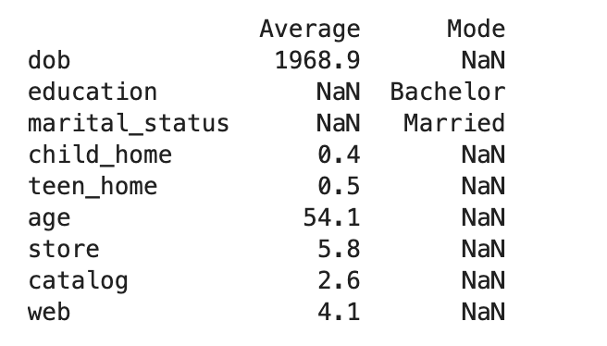
Bon Vivant Delicatessen: Customer Profile
Globally renowned food retailer in the speciality food industry
BVD
54 AVERAGE AGE
MARRIED
BACHELOR’S DEGREE
TEEN AT HOME
MAKES MOST PURCHASES IN THE STORE
WINE
Notes:
Hypothesis: Create a Hypothesis with an emphasis on SMART principles. (S – Specific, M – Measurable, A – Achievable, R – Realistic, T – Timebound). If you cannot do this, you do not have a good grasp on the business problem.
Context: With context, we have clearly identified the problem at hand and have elucidated on how our initiative may solve this problem, alongside the commercial implications this will have on the business.
Criteria for Success: Clearly defining the criteria for success ensures that the scope of your work is clearly defined and understood. Otherwise, if this isn’t defined – your work will never end which will result in mismatched expectations.
Scope of Solution Space: Scoping out the solution space ensures that the business initiative is SPECIFIC for a certain segment or area. This prevents solutions that have been developed being scaled and applied for all other business units that the solution may not be responsible or scalable for.
Constraints within Solution Space: Looking forward, what are the foreseeable problems we are likely to encounter? Could this be stakeholder resistance? Could this be we don’t have access to the right data?
Stakeholders to provide key insight: Who are the people I need to speak to, to get the answers I need for my data analysis?
What key data sources are required?
Based off my discussions with the key stakeholders – can we clearly list out all the data sources we need so we can make a highly targeted request as opposed to a scatter-gun approach where we ask for a bit of everything?

Slide 29
RECOMMENDATIONS
Notes:
Hypothesis: Create a Hypothesis with an emphasis on SMART principles. (S – Specific, M – Measurable, A – Achievable, R – Realistic, T – Timebound). If you cannot do this, you do not have a good grasp on the business problem.
Context: With context, we have clearly identified the problem at hand and have elucidated on how our initiative may solve this problem, alongside the commercial implications this will have on the business.
Criteria for Success: Clearly defining the criteria for success ensures that the scope of your work is clearly defined and understood. Otherwise, if this isn’t defined – your work will never end which will result in mismatched expectations.
Scope of Solution Space: Scoping out the solution space ensures that the business initiative is SPECIFIC for a certain segment or area. This prevents solutions that have been developed being scaled and applied for all other business units that the solution may not be responsible or scalable for.
Constraints within Solution Space: Looking forward, what are the foreseeable problems we are likely to encounter? Could this be stakeholder resistance? Could this be we don’t have access to the right data?
Stakeholders to provide key insight: Who are the people I need to speak to, to get the answers I need for my data analysis?
What key data sources are required?
Based off my discussions with the key stakeholders – can we clearly list out all the data sources we need so we can make a highly targeted request as opposed to a scatter-gun approach where we ask for a bit of everything?

Slide 30
Bon Vivant Delicatessen: Recommendations
Globally renowned food retailer in the speciality food industry
BVD
MARKETING
Catalog and in-store offers to drive the 50-60 age group to visit those sales channels
Discounted catalog or in-store offers based on family size
Make offers no more than 4 times
FURTHER ANALYSIS
Correlation between seasonality and purchases
Is there a product that is discounted more often?
Is it because the product goes bad quickly or is it a seasonal issue?
Spending habits of the 30–40-year range
Spending habits of gold (exclusive) products customers
Notes:
Hypothesis: Create a Hypothesis with an emphasis on SMART principles. (S – Specific, M – Measurable, A – Achievable, R – Realistic, T – Timebound). If you cannot do this, you do not have a good grasp on the business problem.
Context: With context, we have clearly identified the problem at hand and have elucidated on how our initiative may solve this problem, alongside the commercial implications this will have on the business.
Criteria for Success: Clearly defining the criteria for success ensures that the scope of your work is clearly defined and understood. Otherwise, if this isn’t defined – your work will never end which will result in mismatched expectations.
Scope of Solution Space: Scoping out the solution space ensures that the business initiative is SPECIFIC for a certain segment or area. This prevents solutions that have been developed being scaled and applied for all other business units that the solution may not be responsible or scalable for.
Constraints within Solution Space: Looking forward, what are the foreseeable problems we are likely to encounter? Could this be stakeholder resistance? Could this be we don’t have access to the right data?
Stakeholders to provide key insight: Who are the people I need to speak to, to get the answers I need for my data analysis?
What key data sources are required?
Based off my discussions with the key stakeholders – can we clearly list out all the data sources we need so we can make a highly targeted request as opposed to a scatter-gun approach where we ask for a bit of everything?

